Slide 1
Fruit Freshness Detection
Milestone Presentation

Slide 2
Group Members
Rashi Tyagi
Diviza Srivastava
Aanya Maurya

Slide 3
Project Description
This project aims to determine whether fruits are fresh, partially fresh, or rotten using computer vision and image processing techniques. The system analyzes important visual features of fruit images—such as color, texture, and shape—to classify their freshness level automatically.
A dataset of labeled fruit images (fresh and rotten apples, bananas, and oranges) is used. The images are preprocessed by resizing, normalizing, and augmenting them to improve model performance and reliability. Basic image-processing techniques are applied to extract pixel-based features, and visualization methods help understand the differences between fresh and spoiled fruits.
The project ultimately demonstrates how Python and AI-based image analysis can support automation in the food industry, reducing manual inspection effort and ensuring better quality control in fruit distribution and storage.

Slide 4
PROBLEM STATEMENT : In the food industry , fruit freshness is critical for quality control . Manual inspection is often subjective and time consuming . This project aims to automate the process of fruit freshness detection using image – based AI techniques . With the growing demand for automation in food quality monitoring, there is a need for an intelligent system that can accurately and automatically assess fruit freshness. However, building such a system is challenging due to variations in fruit type, color, texture, lighting, and spoilage patterns.
Hence, the problem addressed in this project is:
To design and implement a Python-based automated system capable of detecting and classifying the freshness level of fruits (fresh, partially fresh, or spoiled) using image processing and machine learning techniques.

Slide 5
Limitations
lighting Sensitivity The model's accuracy decreases when images are taken in poor or uneven lighting conditions, which affects color-based classification.
Occlusion Issues If the fruit is partially covered, blocked, or not fully visible, the system may misclassify it.
Limited to Visual Features The system only analyzes color, texture, and shape. Other real-world freshness indicators such as smell, firmness, internal decay, or chemical composition are not considered.
Dataset Dependency The system heavily depends on the quality and variety of the dataset. If the dataset lacks diversity (different lighting, angles, stages of spoilage), the model may struggle in real scenarios.
Generalization Issues The project focuses on a few fruit types (apple, banana, orange). The model may not generalize well to other fruits without retraining.
No Real-Time Detection The current implementation processes images offline and does not support real-time freshness detection for industrial use.

Slide 6
Dataset Details
Name: Fresh and Rotten Fruits Dataset
Source: Kaggle / Self-captured
Classes:
- Fresh/Rotten Apple
- Fresh/Rotten Banana
- Fresh/Rotten Orange
Split: 70% Train, 20% Validation, 10% Test

Slide 7
Script Overview
The script includes:
- Loading dataset
- Counting images
- Displaying samples
- Extracting basic features
- Scaling features
- 3D visualization demo

Slide 8
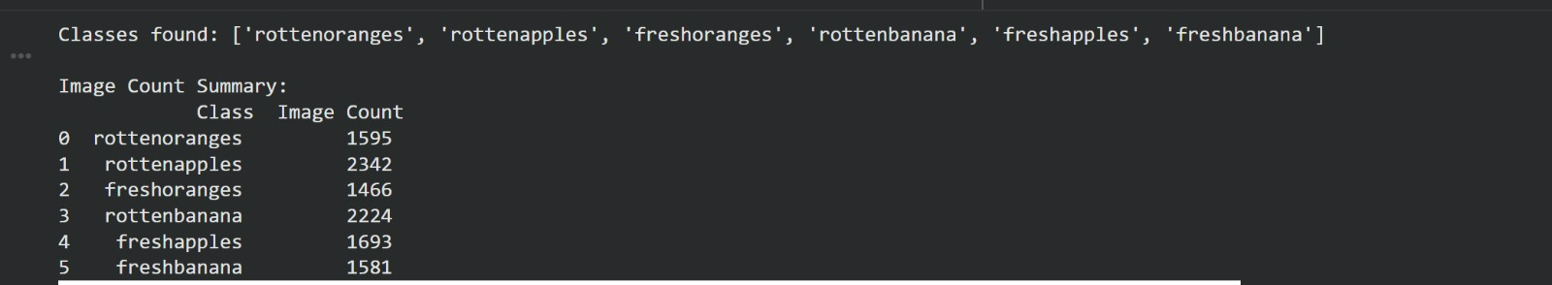
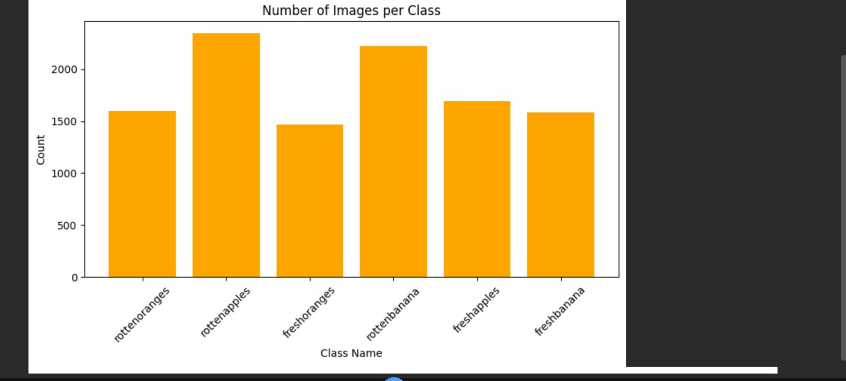
Observations

Slide 9
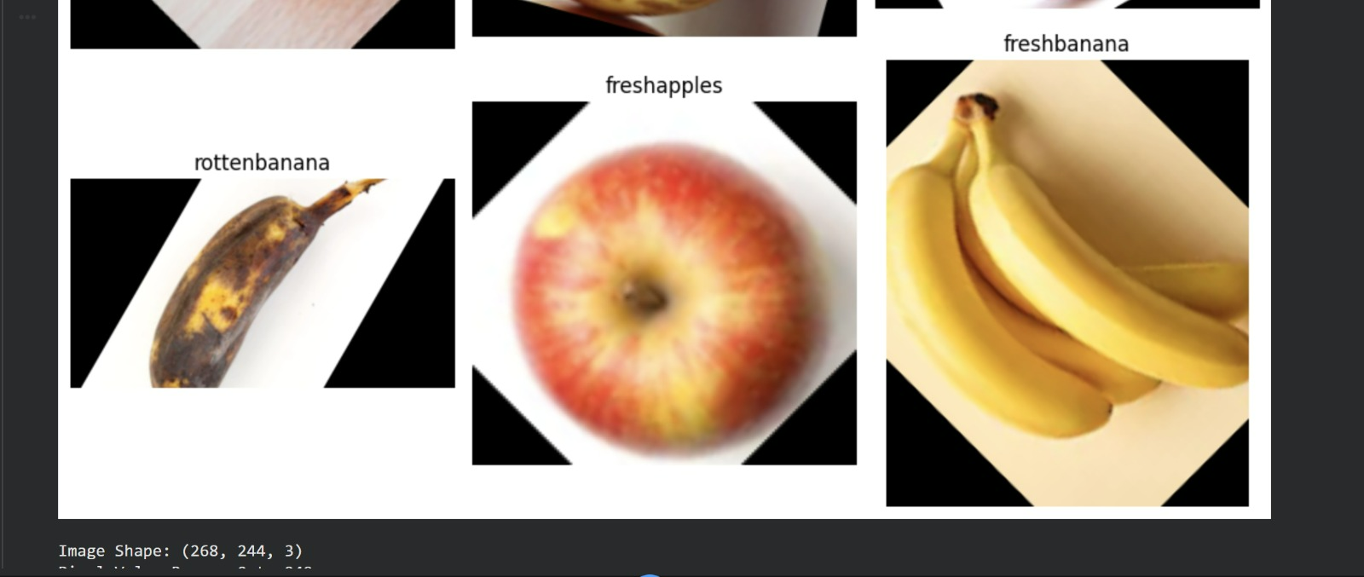
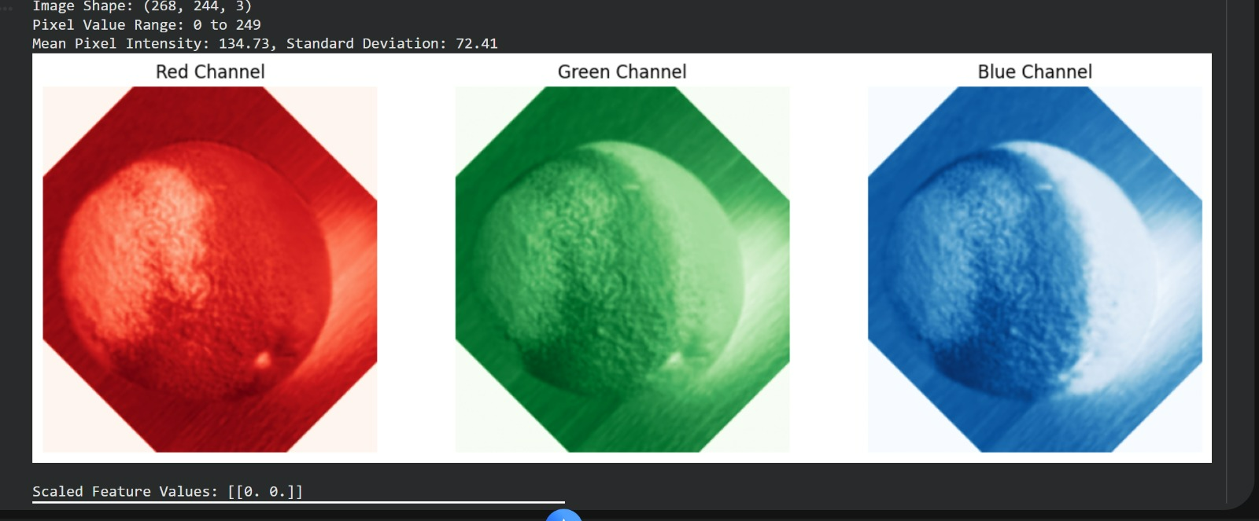

Slide 10
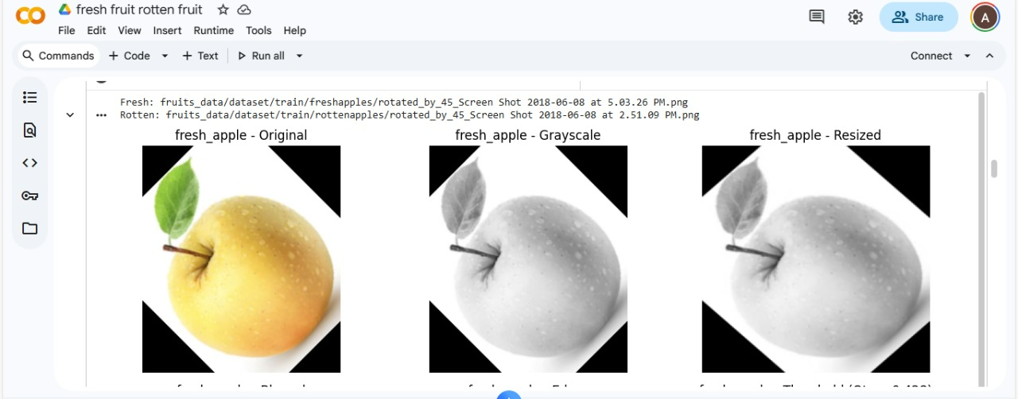
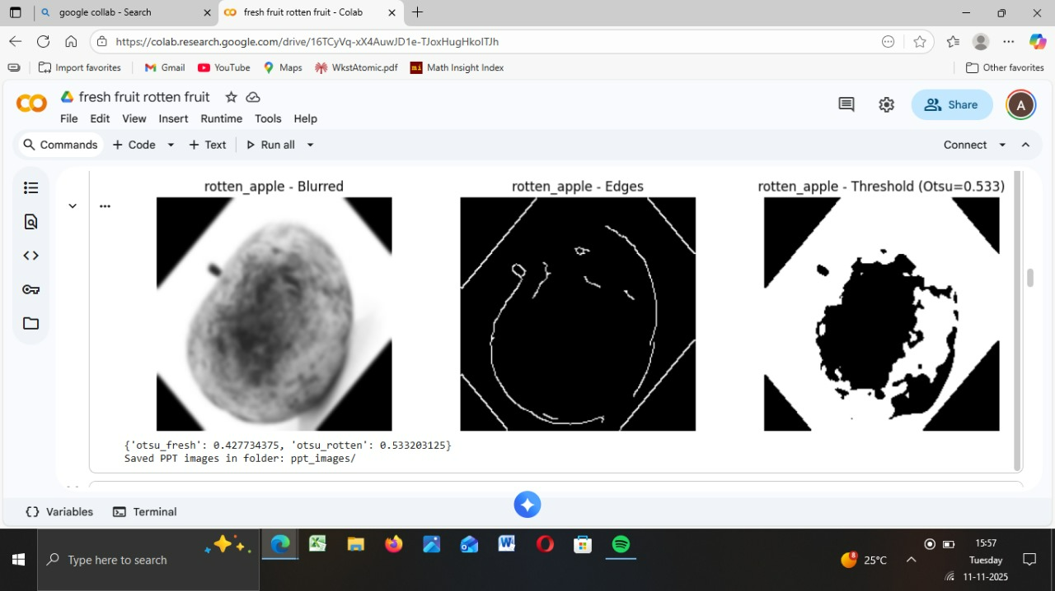
Model classification

Slide 11
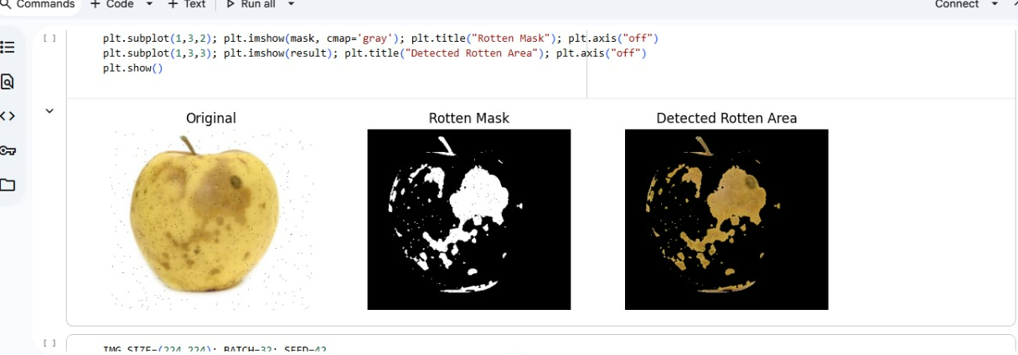
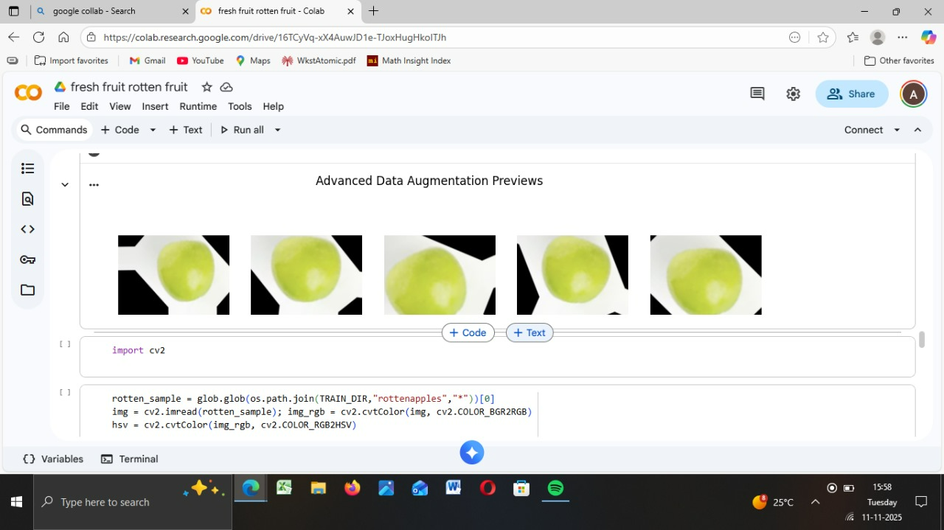

Slide 12
